Slide 1
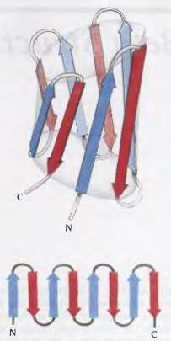
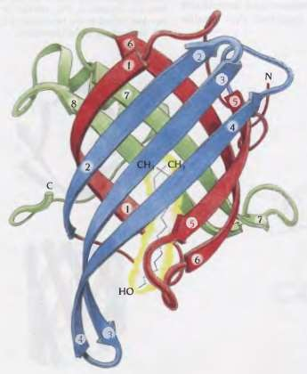
β structure: the core of the domain is built up by β strands that vary in number from 4 to over 10
β strands are arranged in a predominantly antiparallel fashion –
Up and down barrrel - each successive β strand is added adjacent to the previous strand
until the last strand is joined by hydrogen bond to the first strand and the barrel is closed
- the arrangement of β strands is similar to that in α/β barrel structure except that strands are antiparallel and all conections are hairpins
Retinol binding protein:
This protein is responsible for transporting the lipid alcohol vitamin A (retinol) from its storage site in the liver to the tissues

Slide 2
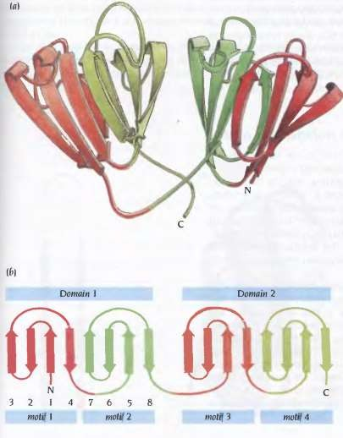
2) Two Greek key motifs form the domain:
γ-crystallin: The transparency and refractive power of the lenses of our eyes depend on a smooth gradient of refractive index for visible light. This is achieved partly by a regular packing arrangement of the cells in the lens and partly by smoothly changing concentration gradient of lens-specific proteins, the crystallins. There are three different classes of crystallins: α, β and γ
Schematic diagram of γ crystallin:
each domain structure is built up from
two β sheets of four antiparallel β strands
Topology diagram of γ crystallin :
Both the domains have the same topology
each domain is composed of two Greek key
motifs that are joined by a short loop region

Slide 3
Protein folding:
The process by which a polypeptide chain acquires its correct three dimensional structure to achieve the biologically active native state is called protein folding
Polypeptide chain folds i) spontaneously
ii) may require the assistance of enzymes to catalyse the formation
and exchange disulfide bonds
iii) may require assistance of a class of proteins called chaperone
How to predict the three dimensional structure of a protein from one dimensional structure?
Proteins in its native state is not static: α helices, β sheets, domains undergo small movements
In general biologically active protein molecules in solution phase is not highly stable
change in pH; temperature
Native state ̶̶ ̶̶ ̶̶ ̶̶ ̶̶ ̶̶ ̶̶ ̶̶ ̶̶ ̶̶ ̶̶ ̶̶ ̶̶ ̶̶ ̶̶ ̶̶ ̶̶ ̶̶ ̶̶ ̶̶ ̶̶ ̶̶ ̶̶ ̶̶ ̶̶ ̶̶ ̶̶ ̶̶ ̶̶ ̶̶ ̶̶ ̶̶ ̶̶ ̶̶ ̶̶ ̶̶ ̶̶ ̶̶ ̶̶ ̶̶ ̶̶ ̶̶ ̶̶ ̶̶ ̶̶ ̶̶ ̶̶ ̶̶ ̶̶ ̶̶ ̶→ Denatured state
∆G ≈ 5 – 15 kcal/mol
(H-bond ≈ 2 to 5 kcal/mol)
⇒ compared to denatured state, native state of a protein is marginally stable
∆G = ∆H - T∆S ⇒ Two major contributors to the energy difference: ∆H; ∆S
∆H : Noncovalent interactions within the polypeptide chain – i) Hydrophobic
interactions; ii) Hydrogen bonds; iii) Ionic bonds
Covalent interactions – Bonds between amino acid residues; disulfide bonds

Slide 4
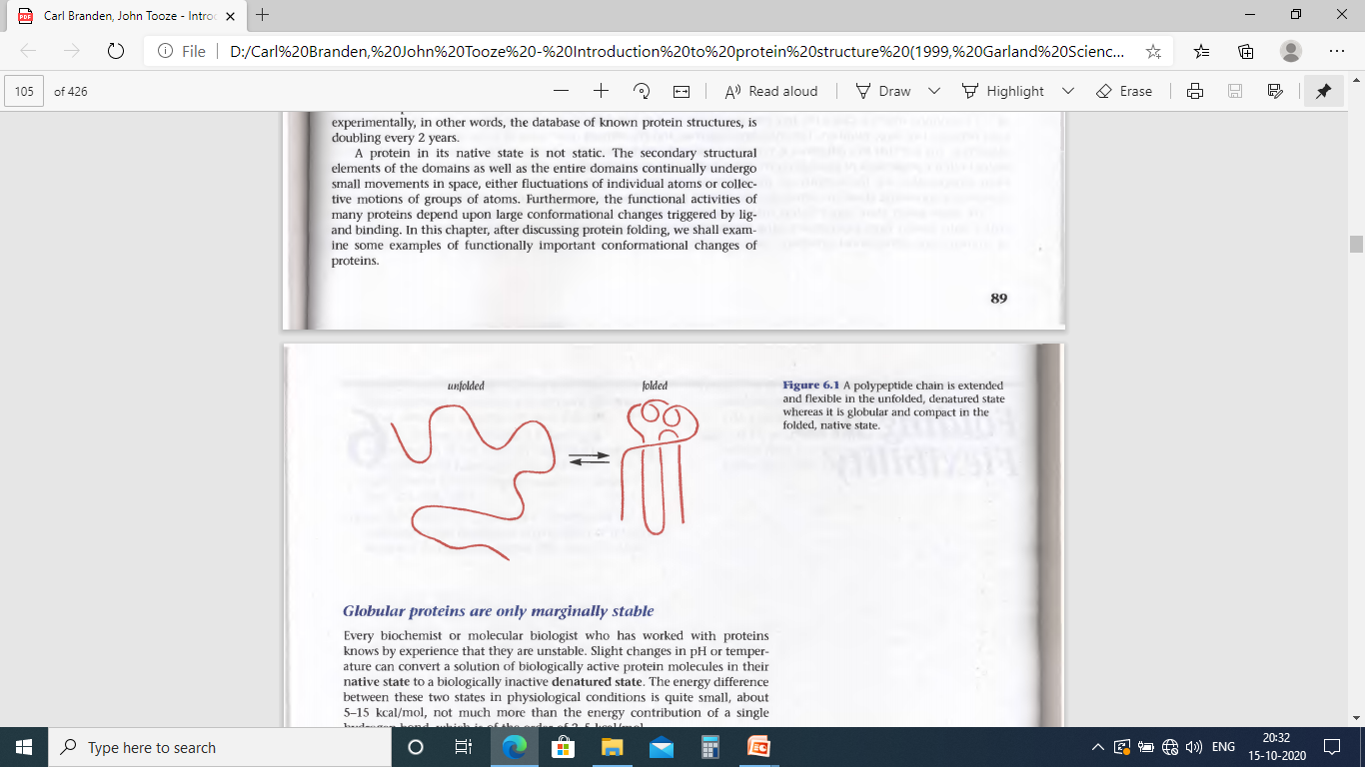
Native state vs Denatured state
Covalent interactions between native and denatured states are same with the exception of
disulfide bonds between cysteine residues of protein
Noncovalent interactions differs significantly –
• Interactions are maximized to produce a compact globular molecule with a tightly
packed hydrophobic core in the native state
• Denatured state is more open and side chains are loosely packed
∆H : ~ several hundred kcal/mol
∆S :
Proteins in the native state are highly ordered in one main conformation whereas the
denatured state is highly disordered with protein molecules in many different conformations
⇒ Denatured state is entropically favourable comapred to the native state of proteins
∆S : ~ several hundred cal/mol
⇒ ∆G : small difference (~ 5 to 15 kcal/mol) between native and denatured state

Slide 5
Native state is marginally stable over the denatured state !!!
It is biologically important to have native proteins in correct quantities in appropriate time
It is important for living cells to be able to easily degrade proteins as it is able to synthesize them
⇒ Therefore native state of proteins evolved to be marginally stable than denatured state
Kinetic factors for folding:
The specific sequence of a polypeptide chain of a protein appears to yield only a single, compact, biologically active fold in the native state
How is this folded state reached ?
Probable pathway : Protein molecule search through all possible conformations in a random fashion until and unless they are frozen at the lowest energy in the conformation of native state
Levinthal’s paradox: (Cyrus Levinthal – 1968)
Each amino acid has only three possible conformations, the allowed regions α, β and L and it converts one conformation into another in a very short time domain, one pico second (10⁻¹² seconds)
⇒ A polypeptide chain of 150 residues would then have 3¹⁵⁰ ≈ 10⁶⁸ possible
conformations
⋙ To search all these conformations would require 10⁶⁸×10⁻¹² = 10⁵⁶ seconds
= 10⁴⁸ hours
≈ 10⁴⁴ years
(astronomical number)
Impossible !!
In living cells (in vivo) and in vitro, the actual folding time is 0.1 to 1000 seconds

Slide 6
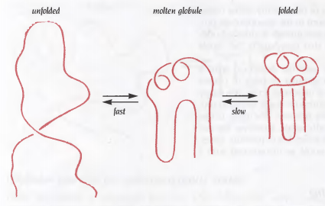
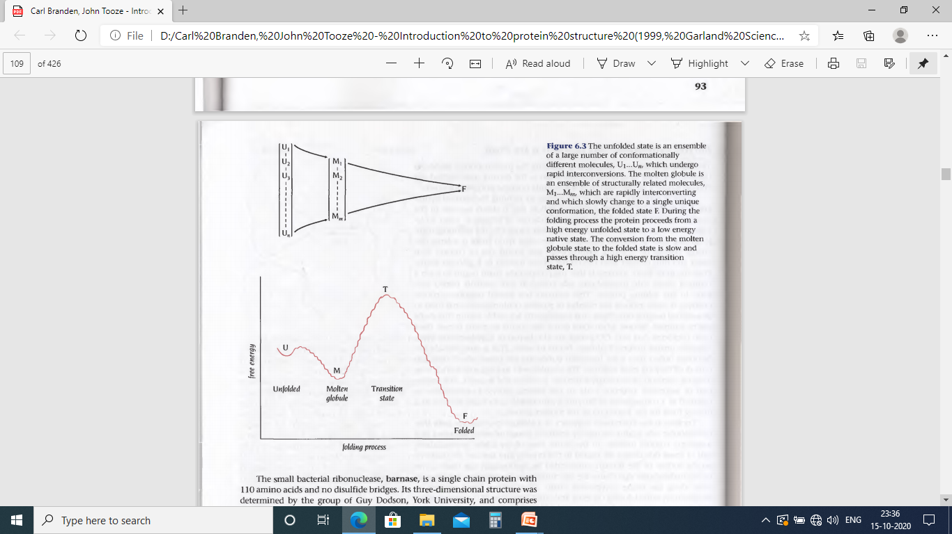
The first observable event in the folding pathway of proteins is a collapse of the flexible disordered unfolded polypeptide chain into partly organised globular structure, Molten Globule
Formation of molten globule is a fast event in the folding pathway, usually within the deadtime of experimental observation (few milliseconds)
The molten globule has most of the secondary structure of the native state and in some cases even native like positions of the α helices and β strands
It is less compact than the native structure and proper packing interactions in the interior of the protein have not been formed
The interior side chains may be mobile, more closely resembling a liquid than solid like interior of native state
Loops and other elements of surface structure remain largely unfolded, with different conformations. Thus molten globule is not single structural entity but as an ensemble of related structures that are rapidly interconverting
In the second step (~1 second) a single native structure is formed through the formation of native interactions including hydrophobic packing in the interior, fixation of surface loops

Slide 7
What is the Driving force for the collapse of randomly oriented unfolded polypeptide chain to molten globule ?
A little change in ∆G by forming H-bonds in α helices and β sheets
• as unfolded state has equally stable H-bonds with water
secondary structure formation can not be thermodynamic driving force for protein folding!
Large ∆G by bringing hydrophobic side chains out of contact with water to the interior
Likely scenario ⇒ The polypeptide chain begins to form a compact shape with the hydrophobic
side chains at least partially buried early in the folding process
Important consequences : • It vastly reduces the number of possible conformations that need to be
searched because only these that are sterically allowed can be sampled
• When some of the side chains are partially buried, –NH and –CO groups of
their backbone are also buried in hydrophobic environment and are unable
to form H-bonds with water
This is energetically unfavourable until they form H-bonds to each other
⇒ formation of α helices and β sheets
The formation of secondary structure (α helices and β sheets) early in folding process
can therefore be regarded as a consequence of burying hydrophobic side chains and
not as a driving force for the formation of molten globule

Slide 8
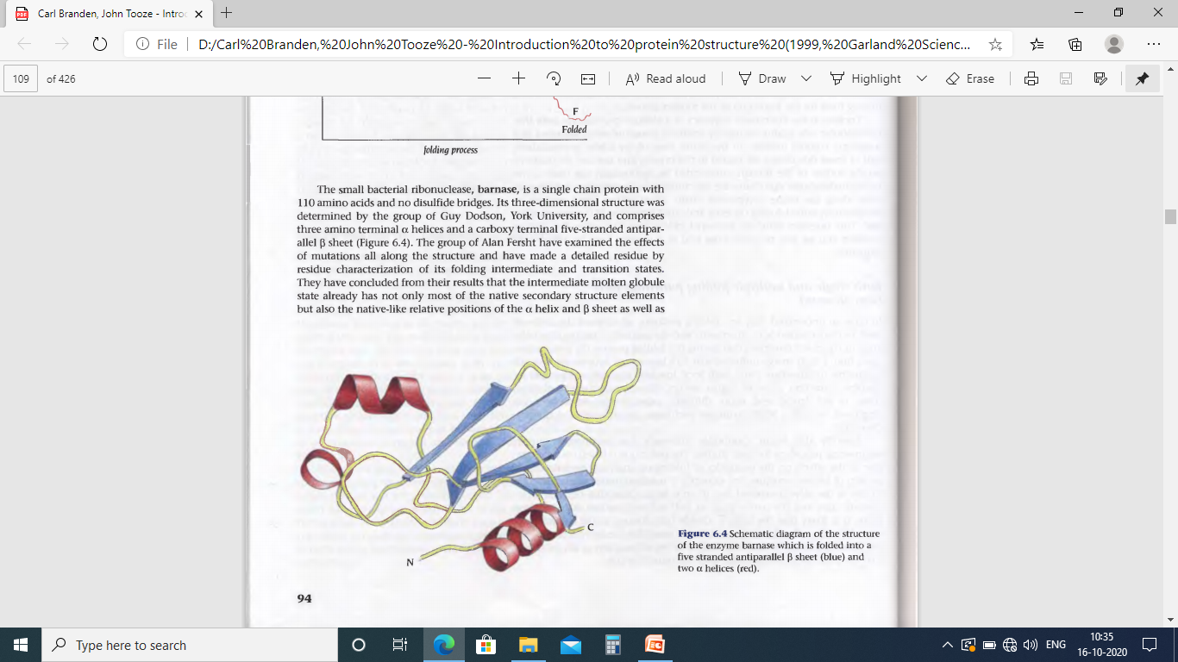
Folding: Protein molecule proceeds from high energy unfolded state to a low energy native state through metastable intermediate with local energy minima separated by unstable transition state of high energy
⇒ important to characterise these intermediate states
To investigate the folding pathway Alan Fersht developed an unique technique:
Effect on the energetics of folding upon single site mutation in protein of known structure
Example: Let, Ala to Gly mutation in the solvent exposed face of an α helix results in destabilisation of both intermediate and native states then α helix has already formed in the molten globule state. If the mutation destabilises the native state but not the intermediate state then α helix has not formed in the molten globule state.
The intermediate molten globule state has not only most of the native secondary structural elements but also the native like relative positions in the α helix and β sheet as well as the relative positions of the β strands within the β sheet
Barnase
Folding of Barnase proceeds through single major transition state and consequently through one major pathway

